Slide 1

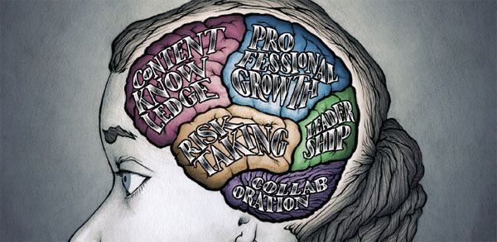


Teachers & teacher content knowledge in SA
Finding a way forward
www.nicspaull.com/presentations
CPLO Roundtable on Teachers | 13 October 2014

Slide 2
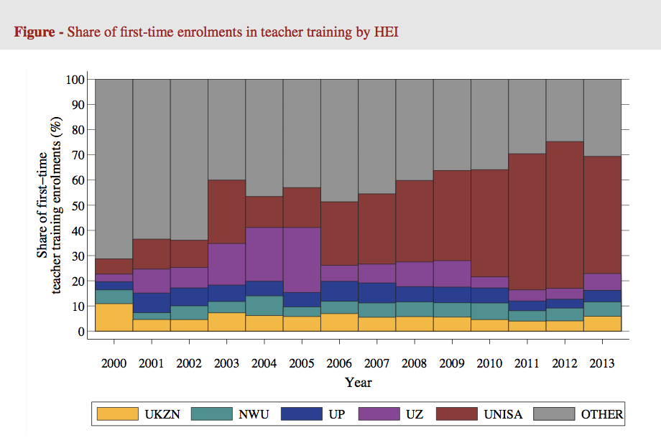
Hendrik van Broekhuizen (ongoing research)

Slide 3
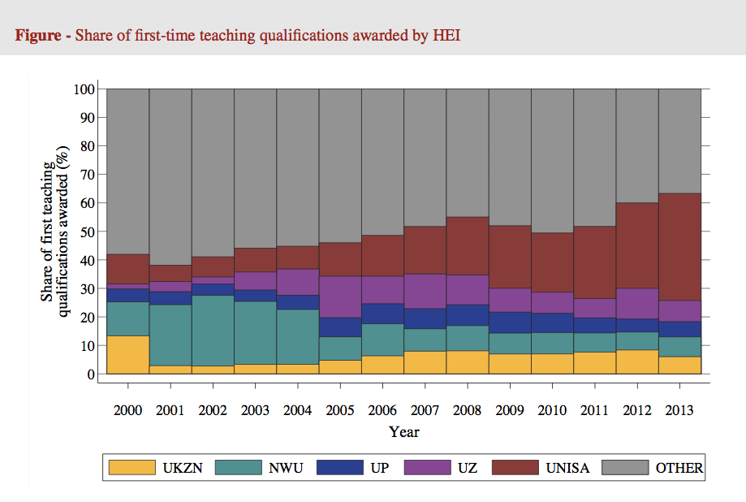
Hendrik van Broekhuizen (ongoing research)

Slide 4
Language and province
(Analysis by Martin Gustafsson using ASS)
This should also make us cautious about extrapolating the findings of GPLMS to other provinces

Slide 5
Possible solution…
The DBE cannot afford to be idealistic in its implementation of teacher training and testing
  Aspirational planning approach: All primary school mathematics teachers should be able to pass the matric mathematics exam
    (benchmark = desirable teacher CK)
  Realistic approach: (e.g.) minimum proficiency benchmark where teachers have to achieve at least 90% in the ANA of the grades in which they teach, and 70% in Grade 9 ANA
  (benchmark = basic teacher CK)
First we need to figure out what works!
Pilot the system with one district. Imperative to evaluate which teacher training option (of hundreds) works best in urban/rural for example. Rigorous impact evaluations are needed before selecting a program and then rolling it out
Tests are primarily for diagnostic purposes not punitive purposes
Notes:
Implement a nation-wide system of minimum-proficiency diagnostic teacher testing and capacitation for numeracy and literacy starting with the Foundation Phase.
“The existing body of evidence suggests that a large proportion of South African teachers have below-basic content knowledge in the subjects that they teach – largely as a result of inadequate apartheid-era teacher training and the ineffectiveness of in-service teacher training initiatives. In light of this, and following the premise that teachers cannot teach what they do not know, it is a logical imperative that a system of identifying which teachers need what help is urgently required. Given the current state of teacher content knowledge in poor and rural schools, the Department cannot afford to be idealistic in its implementation of this system of teacher testing and training. Rather than ascribing to the aspirational planning approach that has become characteristic of South African policy - where one might set an impractically high benchmark for desirable teacher content knowledge - one should first aim to ensure that every teacher in the system has the basic content knowledge required to cover the curriculum that they currently teach. For example, rather than decreeing that every primary school mathematics teacher should be able to pass the matric mathematics exam, it would be far more realistic to take an incremental approach and set the minimum-proficiency benchmark at a 70% mark on the grade nine annual national assessment, combined with at least a 90% mark in the ANA of the grade which they are currently teaching. If a grade six mathematics teacher cannot achieve 70% on the grade nine ANA for mathematics, and achieve 90% for the grade six mathematics ANA, one can say that they do not currently possess the requisite content knowledge to teach grade six mathematics. As a matter of urgency, they should be required to undergo minimum-proficiency teacher training for the subjects which they teach and then re-assessed at the end of the training. Before trying to get every teacher to a desirable level, first ensure that all teachers have the basic content knowledge in the subjects that they teach.
Given the logistics involved with implementing a testing and training operation of this scale, it is advisable to pilot the system with one district and then to roll out the system nationally in a progressive way. For example the Department could start with Foundation Phase (FP) mathematics teachers in a particular district and require all FP maths teachers to register and write the minimum proficiency test within six months. Teachers who do not meet the minimum-proficiency benchmark for the subjects that they teach should be given six months to complete the minimum-proficiency training which should be free of charge and accessible. Importantly, the training provided should be dignified, highly practical, structured and sequenced, with formative testing built into each module to assess whether or not the teacher has acquired the necessary knowledge and skills.
In order to get teacher and union buy in, it will need to be made explicit that these tests are primarily for diagnostic rather than punitive purposes. Through a variety of mechanisms (such as contracts and confidentiality clauses) it is possible to reassure all parties involved that these tests are truly developmental in nature. The ultimate aim of such a system should not be to vilify and demean teachers and the teaching profession, but to increase the capacity and dignity of teachers. Elmore (2004b, p. 93) provides a useful description of the interplay between accountability and capacitation:
“For every increment of performance I demand from you, I have an equal responsibility to provide you with the capacity to meet that expectation. Likewise, for every investment you make in my skill and knowledge, I have a reciprocal responsibility to demonstrate some new increment in performance.”
Spaull 2013 CDE Report

Slide 6
Current situation RE teacher development
Currently there are no in-service training programs that have been rigorously evaluated and shown to improve mathematics teacher content knowledge, at least not at any scale (circuit or higher).
  This is one of the SCANDALS of higher education post-apartheid
Although there are many small NGO initiatives, most are not evaluated and it is unclear if the training:
  Actually works (does what it intends to do)
  changes classroom behavior,
  improves student learning
  Is scalable from capacity, cost and/or program-design perspectives

Slide 7
What can unions do going forward?
Stage 1 - Develop well-specified professional development programs which aim to improve mathematics teacher content knowledge (CK) & pedagogical content knowledge (PCK)
Stage 2 – Evaluate the best candidates from Stage 1 in a small-scale setting (i.e. 50-150 teachers).
(If programs are successful proceed to stage 3)
Stage 3 – Determine whether programs that were successful at Stage 2 (i.e. small scale) can be enacted with integrity in different settings and by different professional development providers (i.e. 300-1000 teachers)
Stage 4 – If programs can have been shown to be effective at raising teachers’ mathematics content knowledge at scale (i.e. Stage 3). Roll out to an entire districts/provinces. Evaluate province-wide interventions.
See Borko, H. (2004) Professional development and teacher learning: Mapping the terrain.
Educational Researcher, 33(8), 3-15.

Slide 8
What can unions do going forward?
Main contribution of unions.
Identify master-teachers from existing members, provide time and resources to develop teacher-training programs
Stage 1 - Develop well-specified professional development programs which aim to improve mathematics teacher content knowledge (CK) & pedagogical content knowledge (PCK)
Stage 2 – Evaluate the best candidates from Stage 1 in a small-scale setting (i.e. 50-150 teachers).
(If programs are successful proceed to stage 3)
Stage 3 – Determine whether programs that were successful at Stage 2 (i.e. small scale) can be enacted with integrity in different settings and by different professional development providers (i.e. 300-1000 teachers)
Stage 4 – If programs can have been shown to be effective at raising teachers’ mathematics content knowledge at scale (i.e. Stage 3). Roll out to an entire districts/provinces. Evaluate province-wide interventions.
See Borko, H. (2004) Professional development and teacher learning: Mapping the terrain.
Educational Researcher, 33(8), 3-15.

Slide 9
Accountability: teacher absenteeism
(SACMEQ III – 2007 – 996 teachers)
4th/15
Notes:
Absenteeism here is average between both maths and reading teachers

Slide 10
Accountability: teacher absenteeism
(SACMEQ III – 2007 – 996 teachers)
15th/15
Yes, BUT…2007 was a bad year
Notes:
Absenteeism here is average between both maths and reading teachers

Slide 11
Accountability: teacher absenteeism
  Teacher absenteeism is regularly found to be an issue in many studies
    2007: SACMEQ III conducted – 20 days average in 2007 (Spaull, 2011)
    2008: Khulisa Consortium audit – HSRC (2010) estimates that 20-24 days of regular instructional time were lost due to leave in 2008
    2010: “An estimated 20 teaching days per teacher were lost during the 2010 teachers’ strike” (DBE, 2011: 18)
    Importantly this does not include time lost where teachers were at school but not teaching scheduled lessons
      A recent study observing 58 schools in the North West concluded that “Teachers did not teach 60% of the lessos they were scheduled to teach in North West” (Carnoy & Chisholm et al, 2012)
Notes:
Also see Chisholm (2005) and Shisana et al (2005) quoted in HSRC (2010)

Slide 12
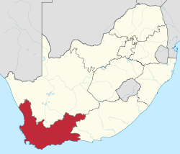
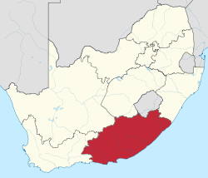
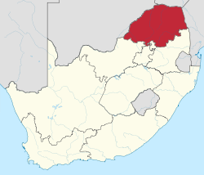
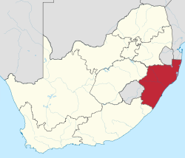
Accountability: teacher absenteeism
(SACMEQ III – 2007 – 996 teachers)
Western Cape
Eastern Cape
Limpopo
KwaZulu-Natal
% absent > 1 week striking
32%
81%
97%
82%
% absent > 1 month (20 days)
22%
62%
48%
73%
% absent > 2 months (40 days)
5%
12%
0%
10%
1.3 days a week
Notes:
Given that SACMEQ was done in September 2007, a maximum of 159 school days could have passed, hence 3 months = 1.3 days a week

Slide 13
Outline
Overview of the SA education system
State of education since the transition
Overview of teacher union membership in SA
Teacher content knowledge in South Africa
What is the role of school management in addressing the problem?
Conclusion

Slide 14
Things to discuss?
Teacher CK
Teacher unions
Teacher training
(in & pre)
Civil service capacity
Resources
Access vs Quality
Grade R / ECD
Accountability & Capacity
LOLT
Student performance
Teacher absenteeism
Learning deficits

Slide 15
Things to discuss?
Teacher CK
Teacher unions
Teacher training
(in & pre)
Civil service capacity
Resources
Access vs Quality
Grade R / ECD
Accountability & Capacity
LOLT
Student performance
Teacher absenteeism
Learning deficits

Slide 16
(1)
An overview of the South African education system

Slide 17
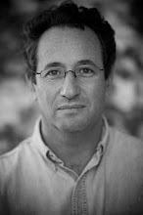
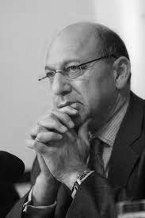
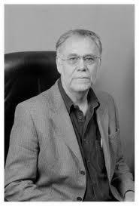
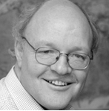
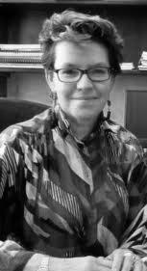
State of SA education since transition
“Although 99.7% of South African children are in school…the outcomes in education are abysmal” (Manuel, 2011)
“Without ambiguity or the possibility of misinterpretation, the pieces together reveal the predicament of South African primary education” (Fleisch, 2008: 2)
“Our researchers found that what students know and can do is dismal” (Taylor & Vinjevold, 1999)
“It is not an overstatement to say that South African education is in crisis.” (Van der Berg & Spaull, 2011)
Notes:
Fleisch, B. (2008). Primary Education in Crisis: Why South African schoolchildren underachieve in reading and mathematics. Cape Town. : Juta & Co.
Taylor, N., Muller, J., & Vinjevold, P. (2003). Getting Schools Working. Cape Town: Pearson Education.
South African education: the poorest choice [M&G, 8 Apr 2011] (Co-authored with Prof Servaas van der Berg)

Slide 18





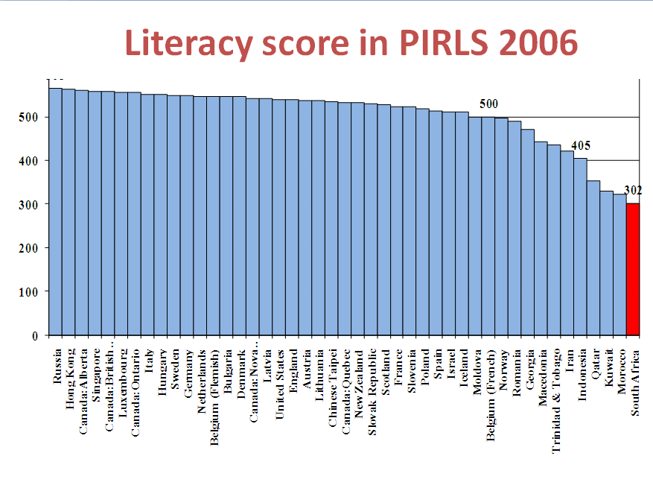
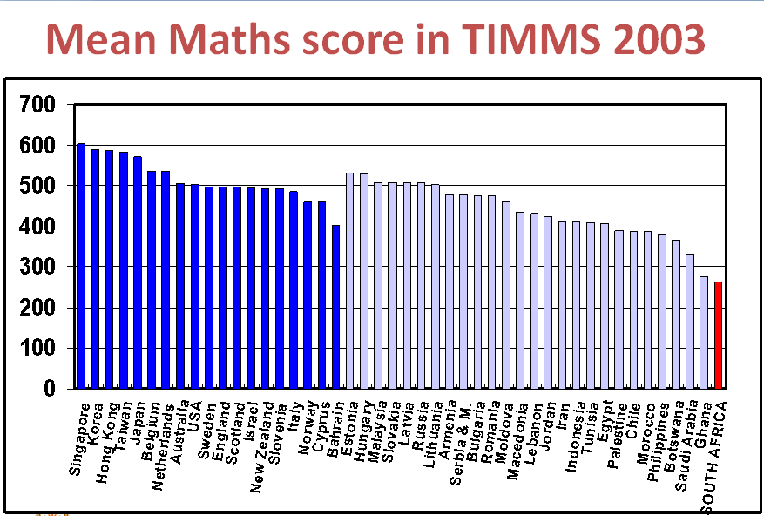
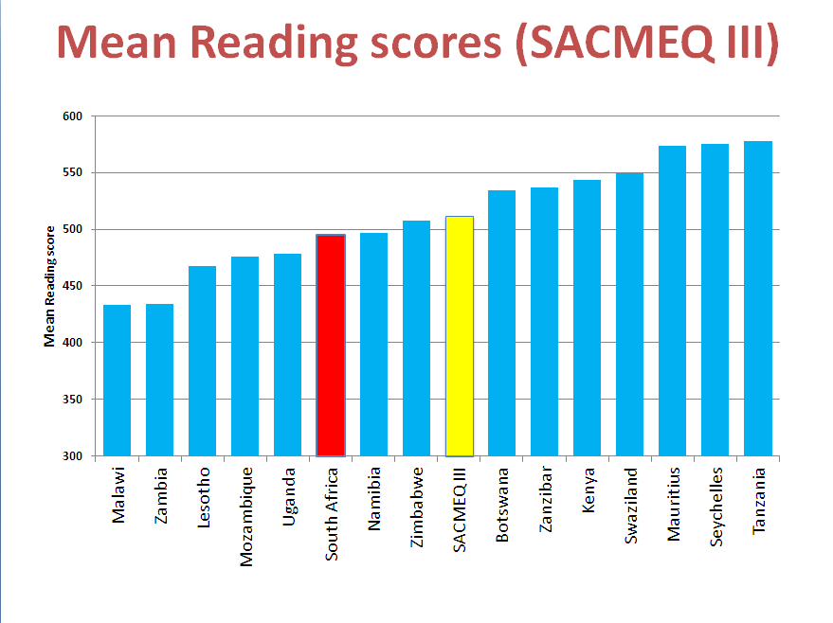
Student performance 2003-2011
TIMSS (2003)
→ PIRLS (2006)
→ SACMEQ (2007)
→ TIMSS (2011)
→ prePIRLS (2011)
TIMSS 2003 (Gr8 Maths & Science)
Out of 50 participating countries (including 6 African countries) SA came last
Only 10% reached low international benchmark
No improvement from TIMSS 1999-TIMSS 2003
See Reddy et al (2006)
PIRLS 2006 (Gr 4/5 – Reading)
Out of 45 participating countries SA came last
87% of gr4 and 78% of Gr 5 learners deemed to be “at serious risk of not learning to read”
See Howie et al. (2006)
SACMEQ III 2007 (Gr6 – Reading & Maths)
SA came 10/15 for reading and 8/15 for maths behind countries such as Swaziland, Kenya and Tanzania
See Moloi & Chetty (2010) & Spaull (2012)
TIMSS 2011 (Gr9 – Maths & Science)
SA has joint lowest performance of 42 countries
Improvement by 1.5 grade levels (2003-2011)
76% of grade nine students in 2011 still had not acquired a basic understanding about whole numbers, decimals, operations or basic graphs, and this is at the improved level of performance
See Reddy et al. (2012) & Spaull (2013)
prePIRLS2011 (Gr 4 Reading)
29% of SA Gr4 learners completely illiterate (cannot decode text in any langauge)
See Howie et al (2012)
NSES 2007/8/9
  Gr 3/4/5
  See Taylor, Van der Berg & Mabogoane (2013)
Systemic Evaluations 2007
  Gr 3/6
Matric exams
  Gr 12
Notes:
The most comprehensive reports for each of these datasets are as follows: SACMEQ (Moloi & Chetty, 2011), TIMSS (Reddy, 2006), PIRLS (Howie, et al., 2008), Systemic Evaluations (Department of Education, 2008), National School Effectiveness Study (Taylor, 2011b),and the Annual National Assessments (Department of Basic Education, 2011).

Slide 19
“But what does this low & unequal performance look like in practice, on the ground, in the classroom?”

Slide 20
NSES question 42
NSES followed about 15000 students (266 schools) and tested them in Grade 3 (2007), Grade 4 (2008) and Grade 5 (2009).
Grade 3 maths curriculum: “Can perform calculations using appropriate symbols to solve problems involving: division of at least 2-digit by 1-digit numbers”
Even at the end of Grade 5 most (55%+) quintile 1-4 students cannot answer this simple Grade-3-level problem.
“The powerful notions of ratio, rate and proportion are built upon the simpler concepts of whole number, multiplication and division, fraction and rational number, and are themselves the precursors to the development of yet more complex concepts such as triangle similarity, trigonometry, gradient and calculus” (Taylor & Reddi, 2013: 194)
(Spaull & Viljoen, 2014)
Notes:
Taylor, N., & Reddi, B. (2013). Writing and learning mathematics. In N. Taylor, S. Van der Berg, & T. Mabogoane, Creating Effective Schools. Cape Town: Pearson.

Slide 21
Insurmountable learning deficits: 0.3 SD
Spaull & Viljoen, 2014 (SAHRC Report)

Slide 22
550,000 students drop out before matric
99% do not get a non-matric qualification (Gustafsson, 2011: p11)
What happens to them? 50% youth unemployment…

Slide 23
(2)
Mathematics content knowledge of SA teachers

Slide 24
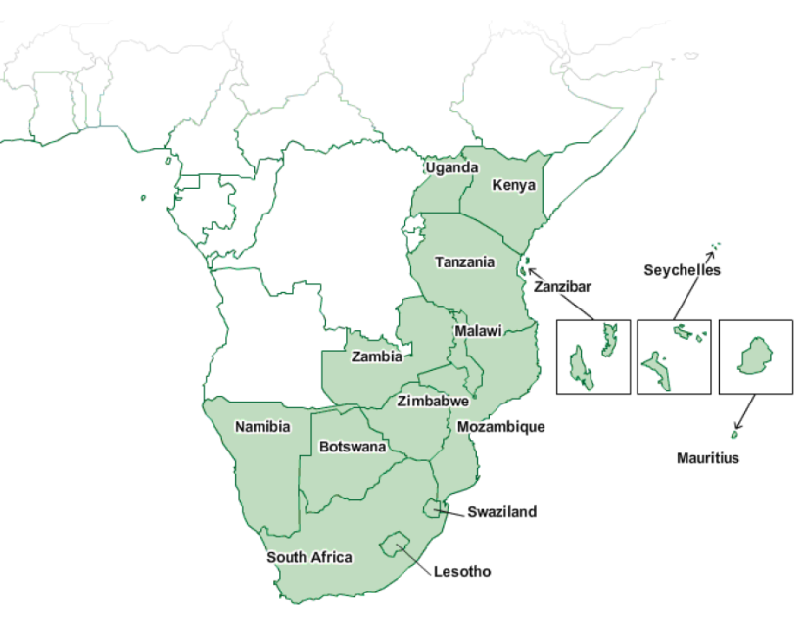
Background: Data
SACMEQ
  Southern and Eastern African Consortium for Monitoring Educational Quality
  14 participating countries
  SACMEQ II (2000), SACMEQ III (2007)
  Nationally representative
  Testing :
    Gr 6 Numeracy
    Gr 6 Literacy
    HIV/AIDS Health knowledge
SACMEQ III: South Africa
  9071 SA Grade 6 students
  498 SA Grade 6 math teachers
  392 SA primary schools
See SACMEQ website for research

Slide 25
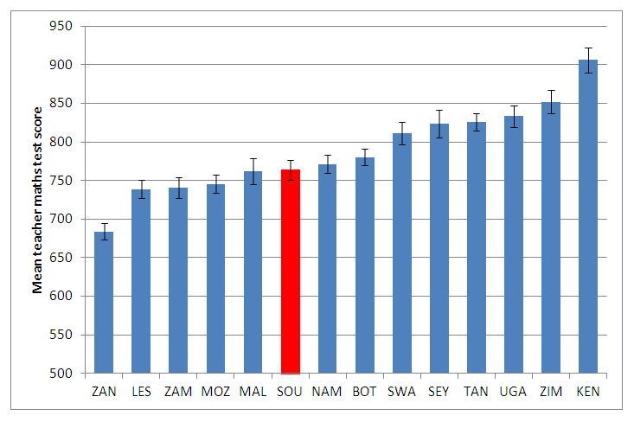
Maths teacher content knowledge (SACMEQ 2007)
But this is the AVERAGE Grade 6 maths teacher. Extremely high levels of inequality in SA means that the average score hides the real truth. What does it look like if we disaggregate it…
Source: Stephen Taylor
Notes:
South African teachers are on the lower end of the distribution of SSA maths teachers, but the average score hides the real truth (as it always does in SA) that some maths teachers in SA perform far below the mean which explains why the variance in maths-teachers maths score in South Africa is so high. The least knowledgeable SA teachers know marginally more than the average STUDENT in South African.
Also, see Makuwa 2010 (on SACMEQ website) for comparable figures for reading teacher content knowledge

Slide 26
“But what does this low performance look like in practice, on the ground, in the classroom?”

Slide 27
(3)
What is the role of school management in addressing problem areas?

Slide 28
Role of SMT
Utilizing existing capacity better.
  There is existing capacity within schools, within groups of schools and within teacher unions that is currently under-utilized.
    Master-teachers
    Mentoring new teachers better (internships? Shadowing?)
Developing a collaborative culture
  “My classroom, my kingdom” thinking is unhelpful. Develop a culture of teachers observing each other teach – not to catch each other out or to punish but to learn and improve.
    “Why do you think no one seemed to understand this particular example?”
    “What works for you?” “How do you teach this?” “How do you think I can do this better?”
  Some teachers are better at teaching some subjects/topics than others. Teachers can learn from each other. We mustn’t be afraid to differentiate and say “We all agree that this teacher is the best at teaching XYZ topic, let them observe our teaching and help us improve”
  Publicly recognizing exceptional teachers. At prize-giving or at big sporting days or other prestigious events, recognize master teachers.
Instructional leadership
  Placing learning at the center of EVERYTHING that the school does. Not rugby or sports or anything else. The chief function of the school is learning. Everyone must know this.
  Leading teacher development – take charge in advocating for improvements to teaching practices
  Protecting instructional time
  Setting clear learning goals
  Understanding what is going on in your classrooms – what are teachers doing? Lesson observations are important, providing constructive feedback on potential improvements
Notes:
http://www.ekon.sun.ac.za/wpapers/2014/wp132014

Slide 29
Instructional leadership
Instructional leadership is about the leadership practices that create the conditions for enhanced teaching and learning, it is about LEADING LEARNING. This is the core function of every principal.
“Management in education is not an end in itself. Good management is an essential aspect of any education service, but its central goal is the promotion of effective teaching and learning…The task of management at all levels of in the education service is ultimately the creation and support of conditions under which teachers and their students are able to achieve learning…the extent to which effective learning is achieved therefore becomes the criterion against which the quality of management is to be judged” (Bush & Heysteck, 2007 p.73)

Slide 30
Instructional leadership
Meta-analysis of 27 published studies of the effect of instructional leadership on student outcomes yielded the following five aspects of school leadership:
  Establishing goals and expectations
    “Goals provide a sense of purpose and priority in an environment where a multitude of tasks can seem equally important and overwhelming. Clear goals focus attention and effort and enable individuals, groups and organizations to use feedback to regulate their performance (p. 661)”
  Resourcing strategically
  Planning, coordinating and evaluating teaching and the curriculum
  Promoting and participating in teacher-learning and development
    “The leader participates in the learning as leader, learner, or both. The contexts for such learning are both formal (staff meetings and professional development) and informal (discussions about specific teaching problems)” (p663)
  Ensuring an orderly and supportive environment
  (Robinson, Lloyd and Rowe, 2008 p.635)

Slide 31
“Managing to Learn” – Hoadley & Ward (2007)
Most SA principals described their main activity in school as administration and the disciplining of learners rather than the managing of teaching and instruction
Factors associated with better performance included
  Curriculum coverage
  Parental valuing of and support for education
  Willingness of the SGB to help the school
  Structuring of the school day for maximum student learning
  Effective management of learning and teacher support materials
  Positive relationships between staff members at the school
  Collaboration between teachers at the school
  School having a plan to improve students results

Slide 32
Questions that need to be answered:
How will we identify “master-teachers” in the profession?
  Teachers who are universally acknowledged to be exceptional teachers and have a desire to help other teachers.
Once we have a successful “Stage 3” intervention, how will we identify teachers that lack content knowledge and pedagogical content knowledge and need the training?
  Testing?
    Who creates the test?
    At what level? Cannot be idealistic (everyone must pass matric math exam). Need to be realistic.
    Voluntary/compulsory?
    VERY important to stress that these tests are DEVELOPMENTAL, not PUNITIVE
Who will provide the funding for these “master-teachers” to develop the professional development program?
  DBE? Teachers need to be given a reduced teaching load (replacement-time funded by DBE?) so that they can develop and implement the program.
Is it possible for the major teacher unions to collaborate?

Slide 33
Conclusion
It is not an exaggeration to say that there is an ongoing crisis in education in South Africa.
Severe inequalities in education translate into severe inequalities in society.
It is not an exaggeration to say that there is an ongoing crisis in mathematics teacher content knowledge .
Teacher unions and SMTs need to act pre-emptively. You know who the best teachers are. You know who should be developing teacher training programs. You cannot just leave it to universities or DBE or NGOs. We need you.

Slide 34
Thank you
Comments & Questions?
This presentation and papers available online at: www.nicspaull.com/research

